Slide 1
MOVIE RECOMMENDER SYSTEMS
CONTENT-BASED AND COLLABORATIVE FILTERING-BASED METHODS
- ABHISHEK H M

Slide 2
INTRODUCTION
Recommendations Systems are used for making product recommendations for numerous applications.
Eg: Online shopping, suggesting interesting web sites, or helping people find music and movies.
Recommendation systems search for people who share tastes and make automatic recommendations based on things that similar people like.
Real life examples where recommendation systems are used.
Amazon (Books, Items), Pandora/Spotify (Music), Google (News, Search), YouTube (Videos) etc.
Content-Based Recommenders rely on the similarity of the items being recommended.
Collaborative filtering produces recommendations based on the knowledge of users’ attitude to items.

Slide 3
DATA SETS USED
The data sets used are two parts of the MovieLens dataset, to build a model to recommend movies to users. This data has been collected by the GroupLens Research Project at the University of Minnesota.
For Content-based method, we have used:
1,000,000 ratings (1-5) from 6040 users on 3900 movies in the year 2000
Demographic information of the users (age, gender, occupation, etc.)
For Collaborative Filtering-based method, we have used:
100,000 ratings (1-5) from 943 users on 1682 movies in the year 1998
Demographic information of the users (age, gender, occupation, etc.)
We have used a smaller data set for collaborative filtering as this method requires a lot of processing power that is not available on a desktop / laptop

Slide 4
DATA PREPROCESSING
Three main files from the data set:
User File containing:
'user_id', 'age', 'sex', 'occupation', 'zip_code’
Ratings File containing:
'user_id', 'movie_id', 'rating', 'unix_timestamp’
Movies File containing:
'movie_id', 'movie_title’, ‘genre’
All the files were mostly clean and a few columns were omitted as they were not required for these two systems

Slide 5
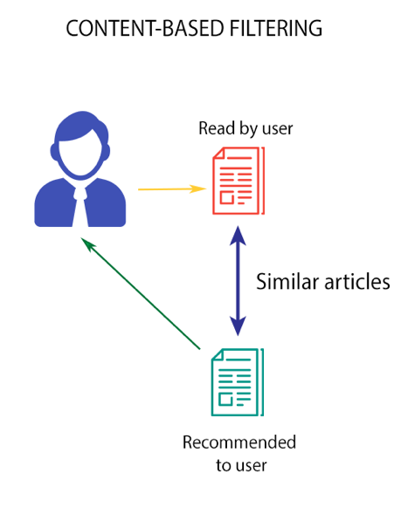
CONTENT BASED SYSTEMS
Content-Based Recommender relies on the similarity of the items being recommended.
Eg: If a user consumes an item ‘A’, then he is likely to consume an item that is similar to item ‘A’.
It generally works well when it's easy to determine the context/properties of each item.
In our case we will determine the similarity based on movie genres.

Slide 6
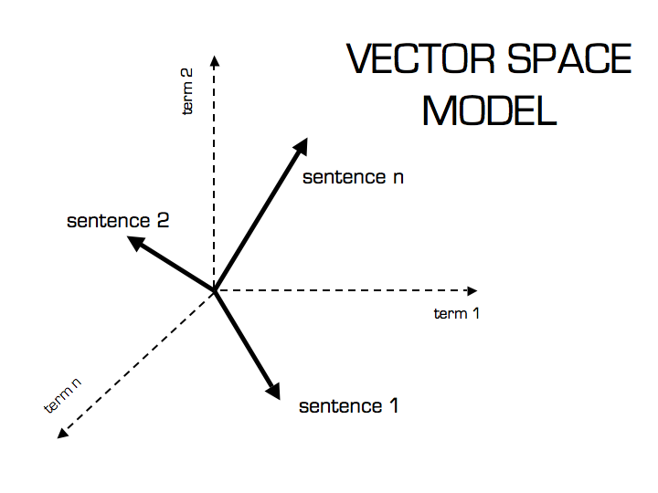
CONTENT BASED SYSTEMS
Theory:
Term Frequency (TF) and Inverse Document Frequency (IDF) are used to determine the relative importance of a movie genre.
We make use of TfidfVectorizer from sklearn to vectorize the genre of every movie from the movies table
We later determine which of the vectors are closer
to each other using cosine similarity. As the angle
Between two vectors reduces the cosine value
Goes up signifying more similarity

Slide 7
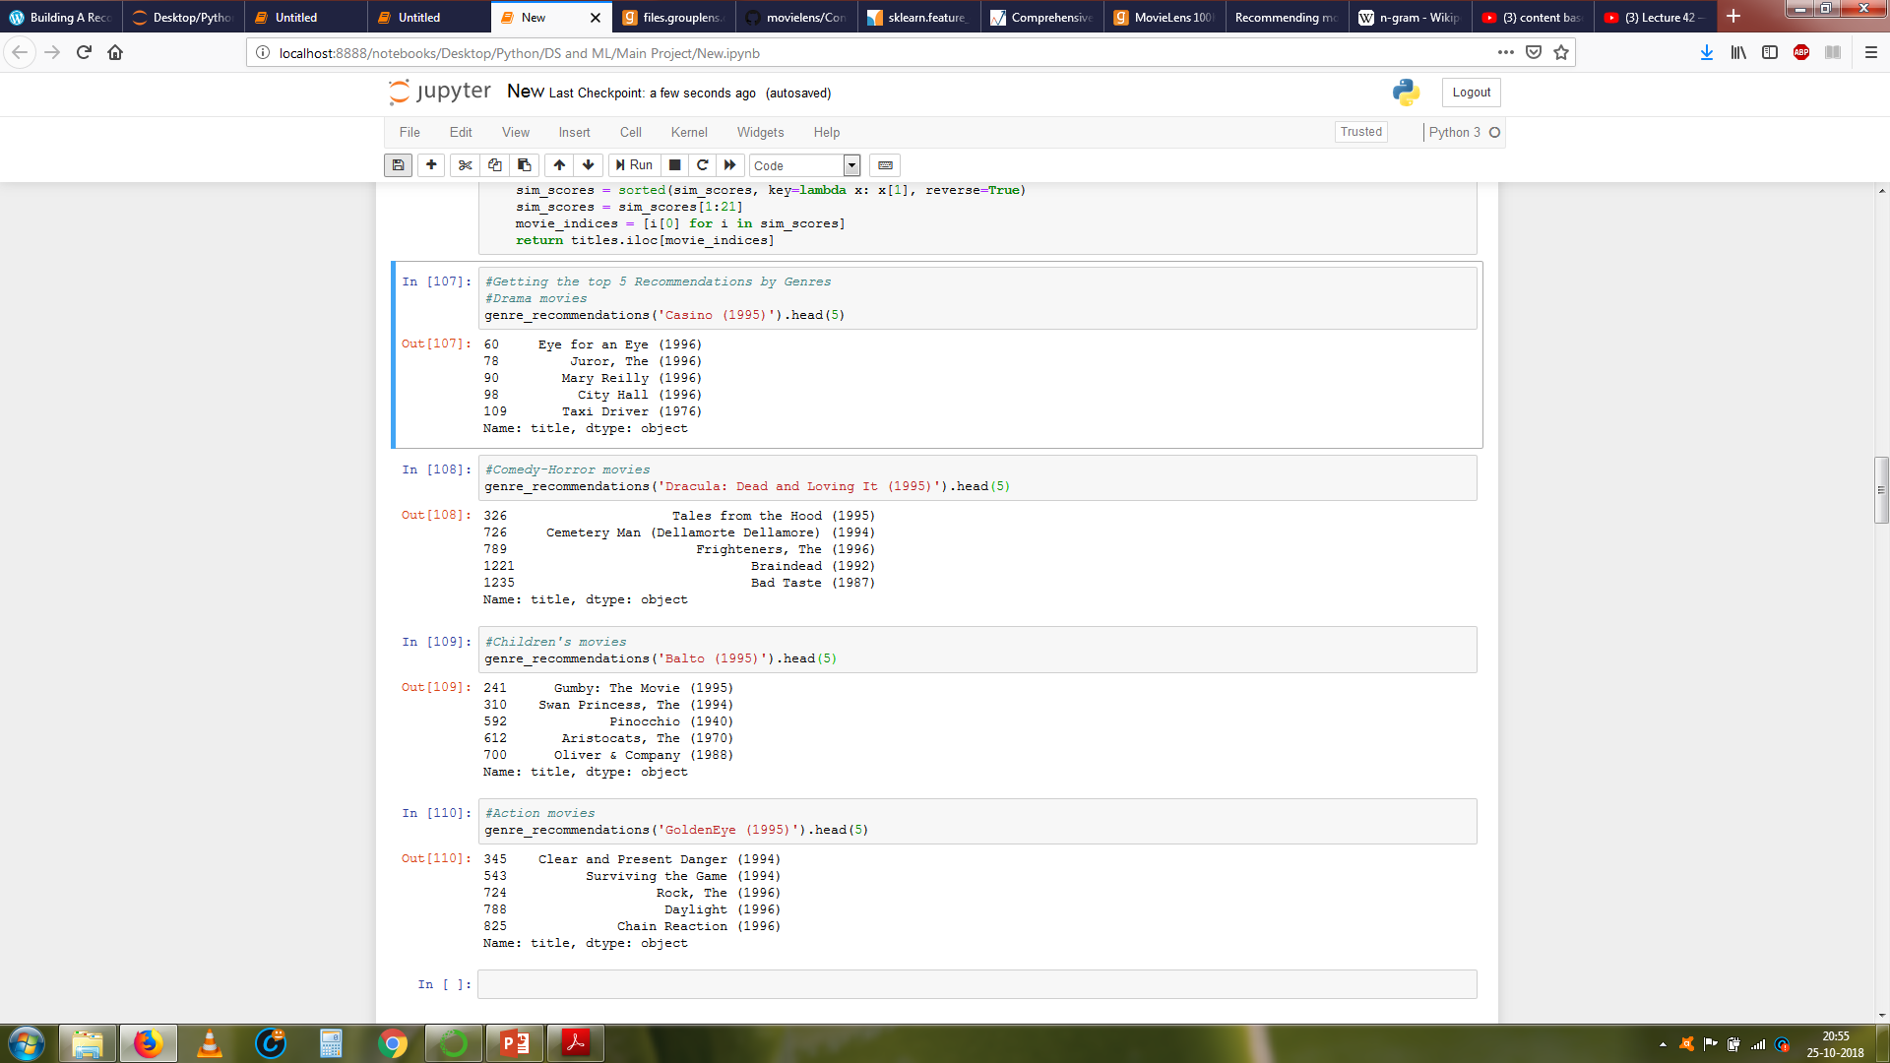
CONTENT BASED SYSTEMS
Results

Slide 8
CONTENT BASED SYSTEMS
Pros of using content-based recommendation:
No need for data on other users, thus no cold-start or sparsity problems.
Can recommend to users with unique tastes.
Can recommend new & unpopular items.
Can provide explanations for recommended items by listing content-features that caused an item to be recommended (in this case, movie genres)
Cons of using this approach:
Finding the appropriate features is hard.
Does not recommend items outside a user's content profile.
Unable to exploit quality judgments of other users.

Slide 9
COLLABORATIVE FILTERING BASED METHODS
Anyone querying the previous model for recommendations will receive the same recommendations for that movie, regardless of who she/he is.
Collaborative Filtering based models make recommendations based on the idea that if a user ‘A’ is similar to another user ‘B’, we can use this information to predict how ‘A’ will like a particular product or service that ‘B’ has used/experienced but ‘A’ have not.
There are two main types of memory based collaborative filtering methods:
User-User Collaborative Filtering
Item-Item Collaborative Filtering

Slide 10
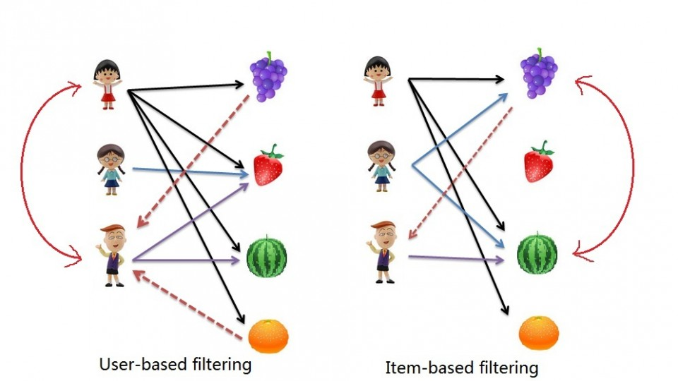
COLLABORATIVE FILTERING BASED METHODS
User-User Collaborative Filtering
Here we find look alike users based on similarity and recommend movies which first user’s look-alike has chosen in past.
This algorithm is very effective but takes a lot of time and resources. It requires to compute every user pair information which takes time.
Therefore, for big base platforms, this algorithm is hard to implement without a very strong parallelizable system.

Slide 11
COLLABORATIVE FILTERING BASED METHODS
It is quite similar to previous algorithm, but instead of finding user's look-alike, we try finding items's look-alike. In our case – movies.
Once we have movie's look-alike matrix, we can easily recommend alike movies to user who have rated any movie from the dataset.
This algorithm is far less resource consuming than user-user collaborative filtering. Hence, for a new user, the algorithm takes far lesser time than user-user collaborate as we don’t need all similarity scores between users.

Slide 12
COLLABORATIVE FILTERING BASED METHODS
Theory
We have similarity tables:
User-User similarity – index: ‘user_id’ with ‘ratings’ as values for ‘movie_id’ column
Item-Item similarity – index: ‘movie_id’ with ratings as values for ‘user_id’ column
We have used the below two methods for calculating the similarity between two item pairs:
Cosine Similarity: (as in the Content-Based system)
Similarity is the cosine of the angle between the 2 vectors of the item vectors of A and B
Closer the vectors, smaller will be the angle and larger the cosine
Pearson Similarity:
Similarity is the pearson coefficient between the two vectors.

Slide 13
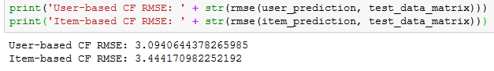
COLLABORATIVE FILTERING BASED METHODS
Using the two similarity matrices, we can then predict which movies to recommend based on the type of similarity chosen
From the User-User similarity matrix we can see which of the users are alike and recommend movies to them accordingly.
From the Item-Item matrix, we can see which of the movies are most similar to the other. We can later recommend these movies to user who hasn’t seen them.
Accuracy

Slide 14
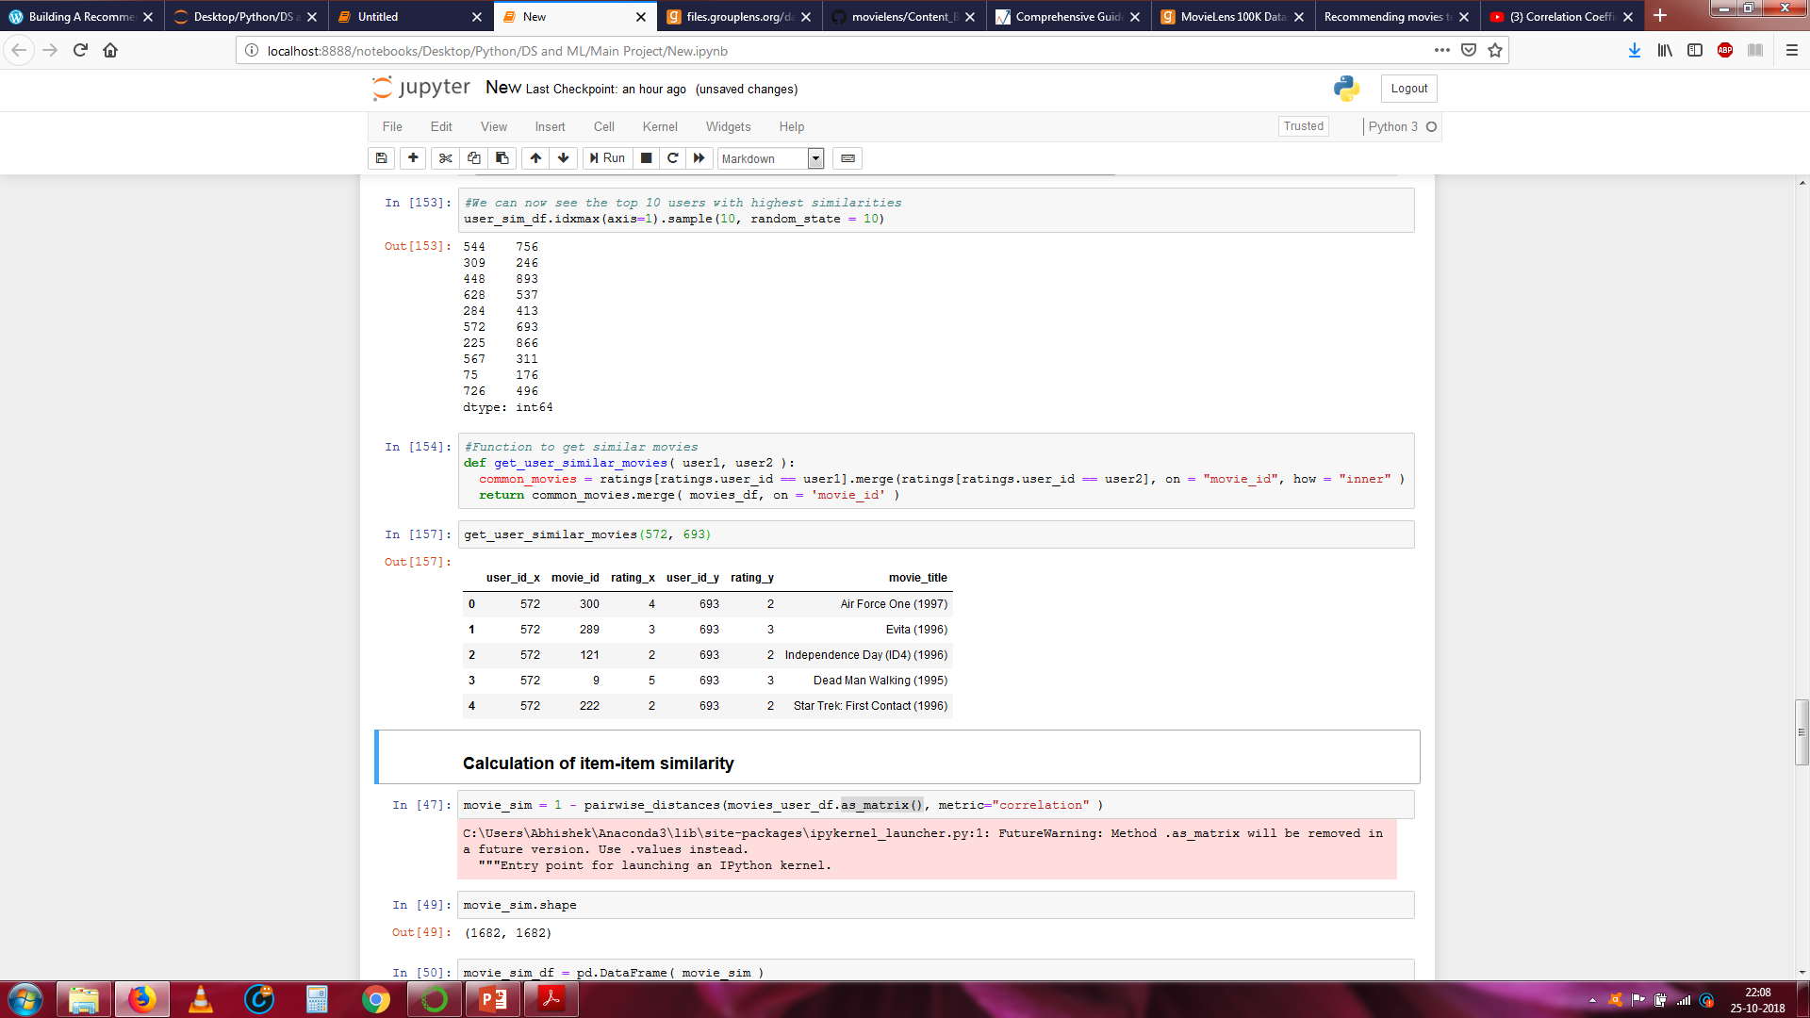
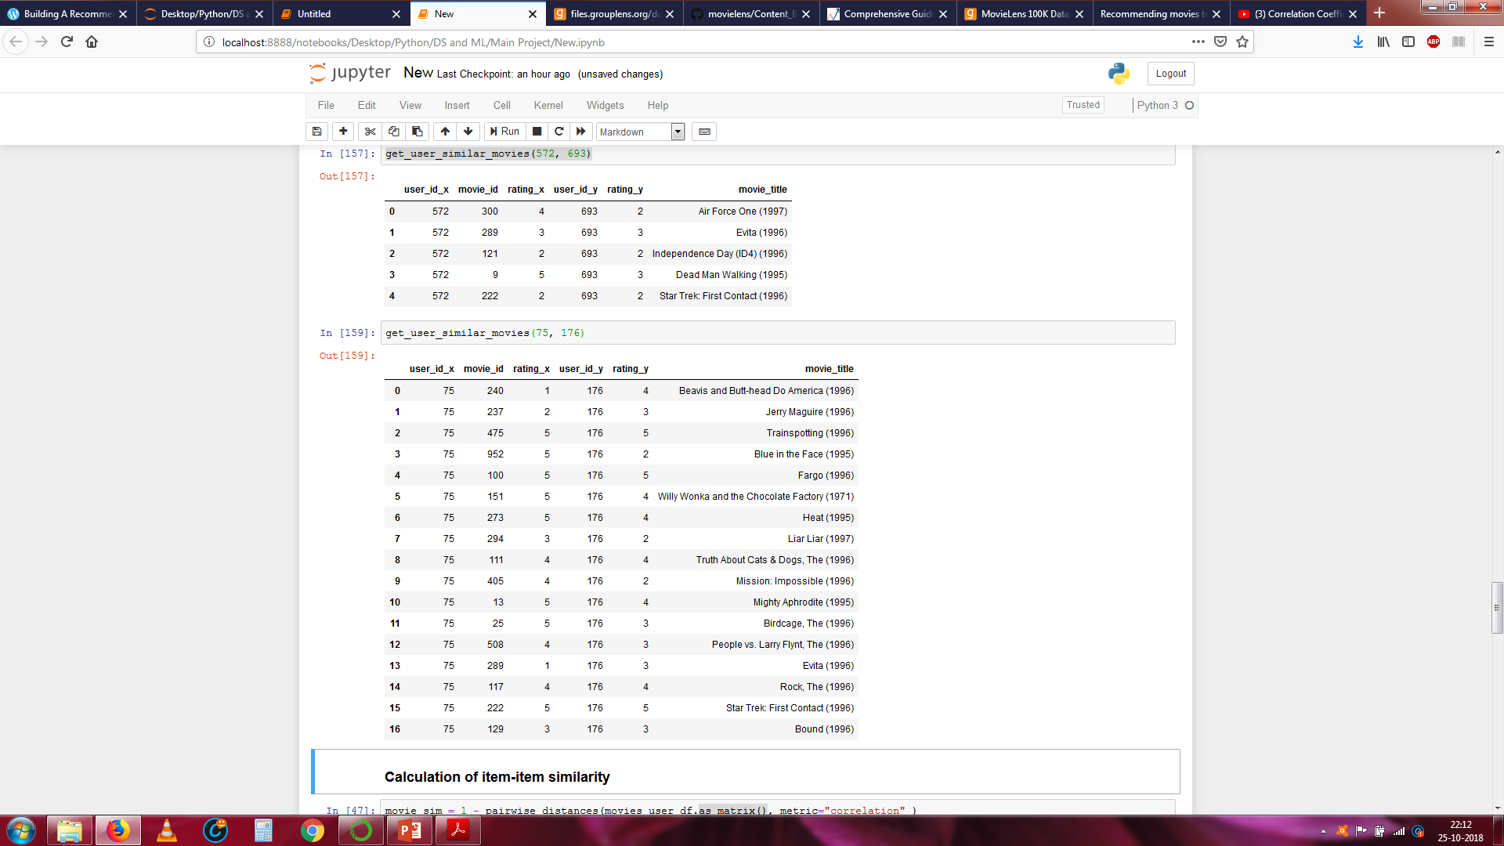
COLLABORATIVE FILTERING BASED METHODS
Results
User Based Filtering

Slide 15
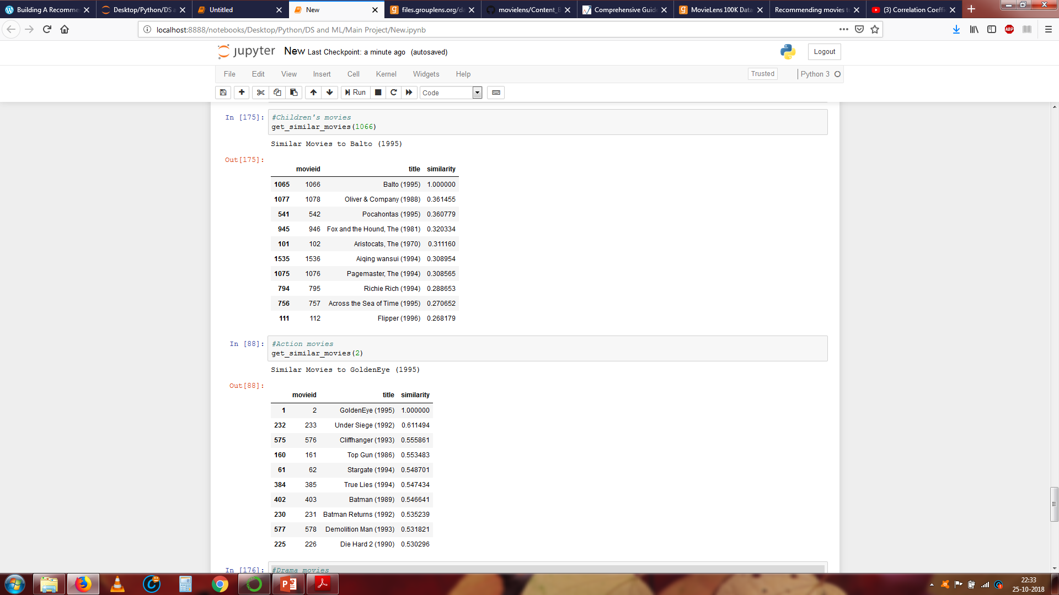
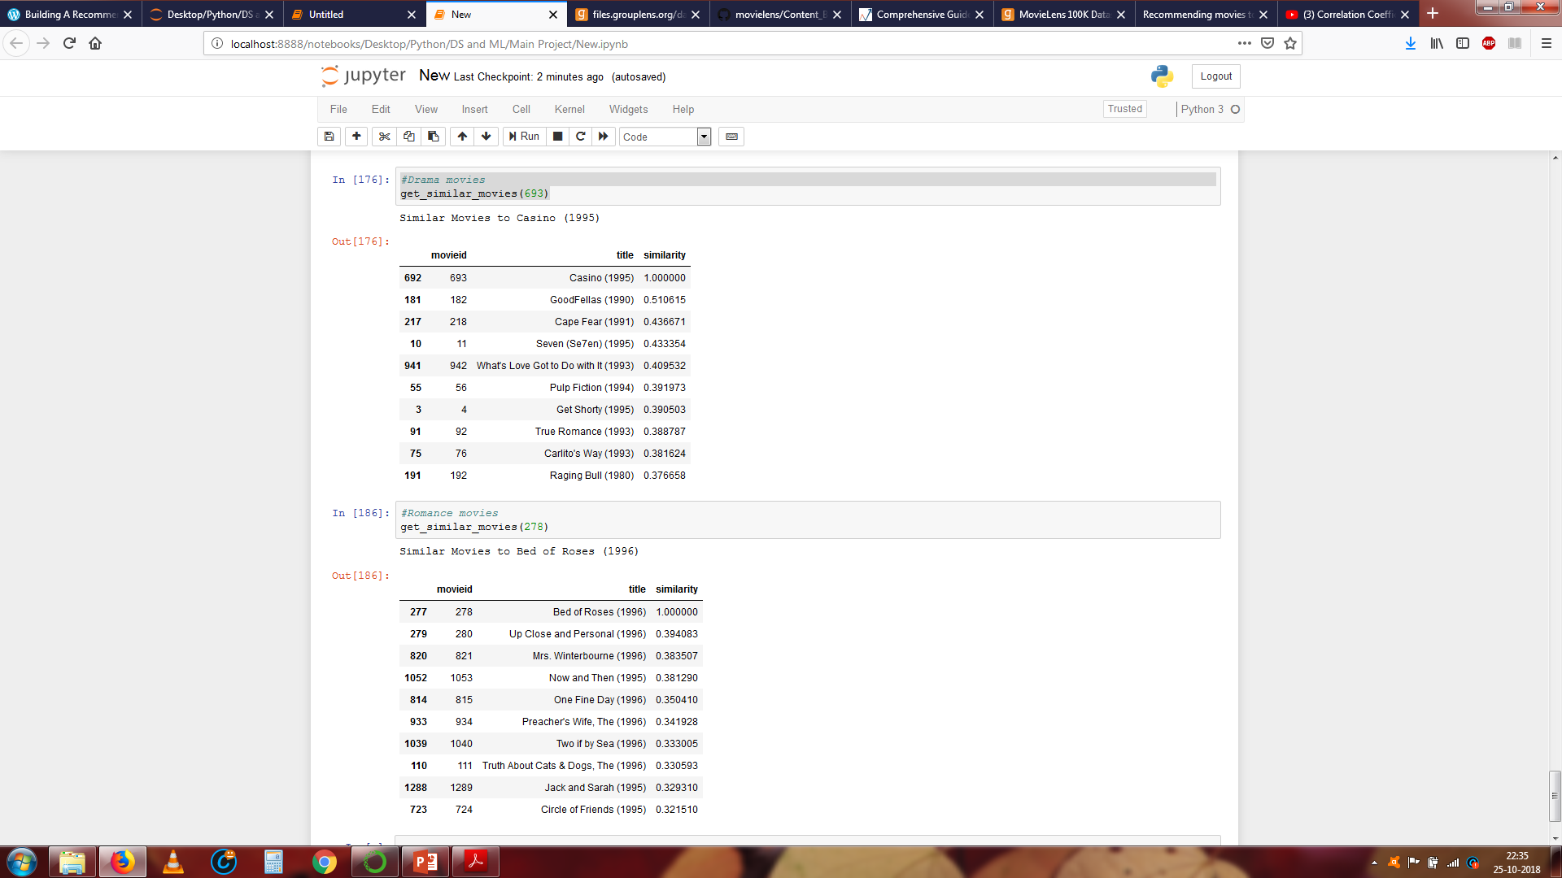
COLLABORATIVE FILTERING BASED METHODS
Results
Item Based Filtering

Slide 16
COLLABORATIVE FILTERING BASED METHODS
Pros of Memory-based Collaborative Filtering:
It is easy to implement.
Algorithm corrects users average rating
Produces reasonable prediction quality.
Cons of Memory-based Collaborative Filtering:
It doesn't address the well-known cold-start problem, that is when new user or new item enters the system.
It can't deal with sparse data, meaning it's hard to find users that have rated the same items.
It suffers when new users or items that don't have any ratings enter the system.
It tends to recommend popular items.

Slide 17
THANK YOU

